Slide 1
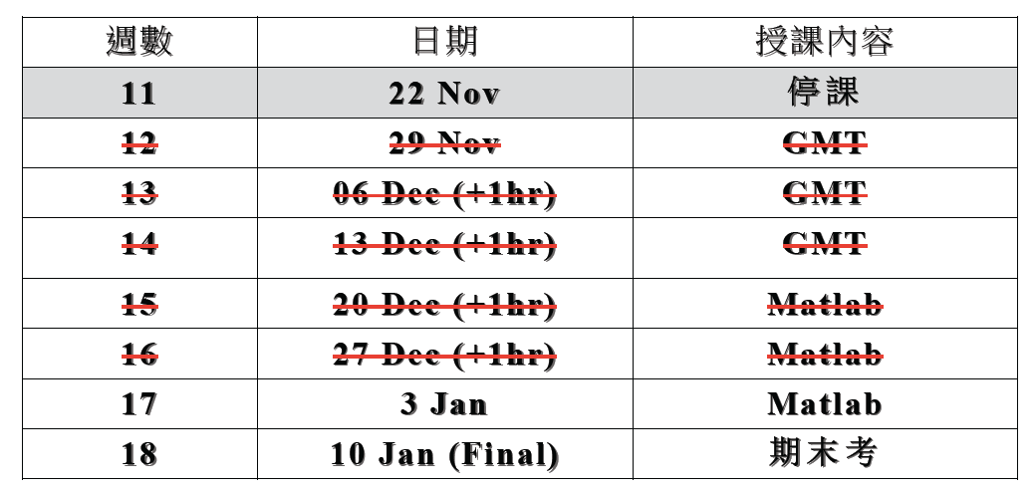

Slide 2
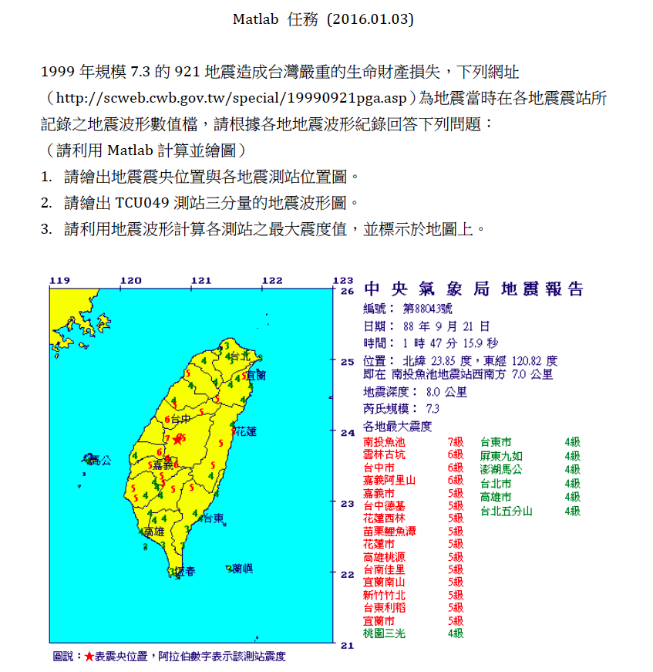

Slide 3
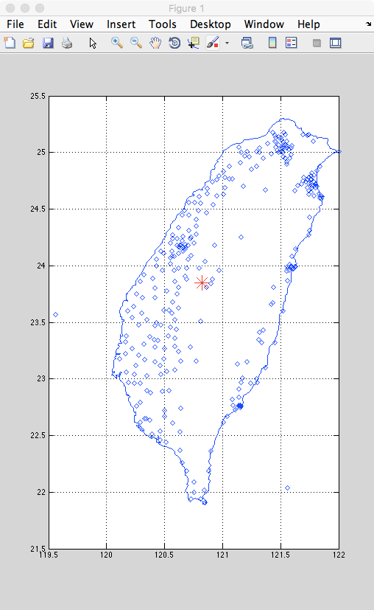

Slide 5
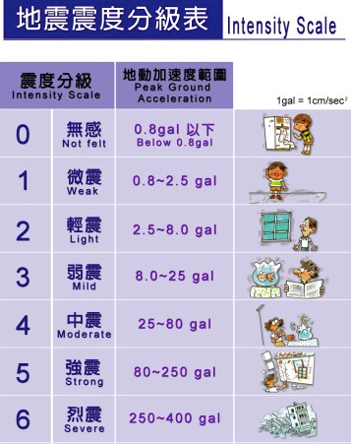
921_eq_info_simple.txt
Sta_code Int. Dist(Km) V(gal) NS(gal) EW(gal) Long. Lat.
TCU049 6 38.32 178.00 241.94 273.42 120.70 24.18
TCU052 7 39.03 193.98 438.68 348.66 120.75 24.20
TCU053 5 40.61 120.88 132.08 224.78 120.68 24.19

Slide 6
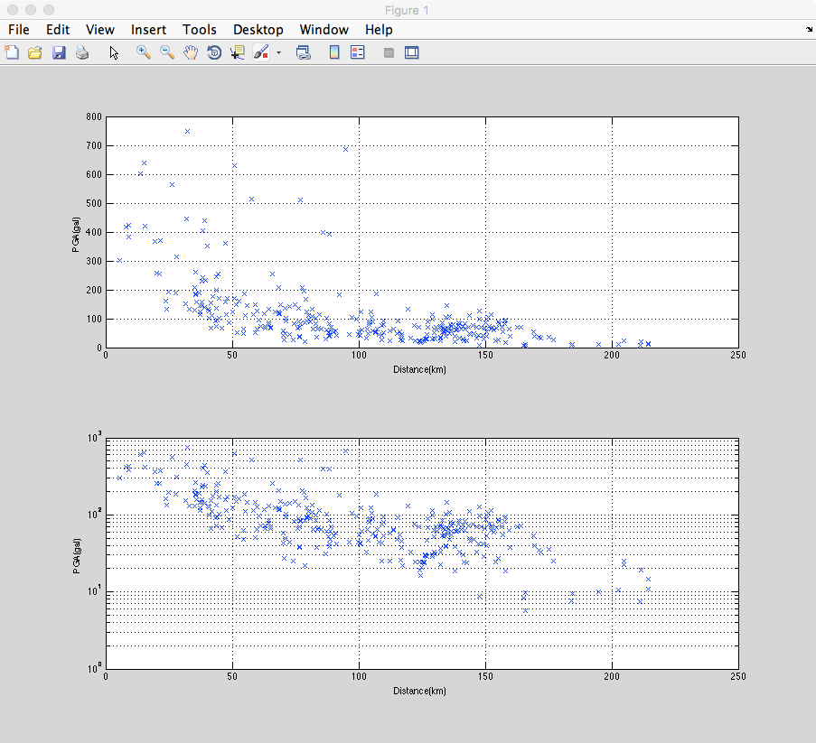

Slide 7
TCU049.txt
#StationCode: TCU049
#InstrumentKind: A900 (T073001.263 )
#StartTime: 1999/09/20-17:47:04.000
#RecordLength(sec): 90.00
#SampleRate(Hz): 200
#AmplitudeUnit: gal. DCoffset(corr)
#AmplitudeMAX. U: 177.985~ -154.703
#AmplitudeMAX. N: 214.663~ -241.960
#AmplitudeMAX. E: 188.812~ -273.374
#DataSequence: Time U(+); N(+); E(+)
#Data: 4F10.3
0.000 0.096 -0.310 -0.082
0.005 -0.083 -0.968 0.815

Slide 8
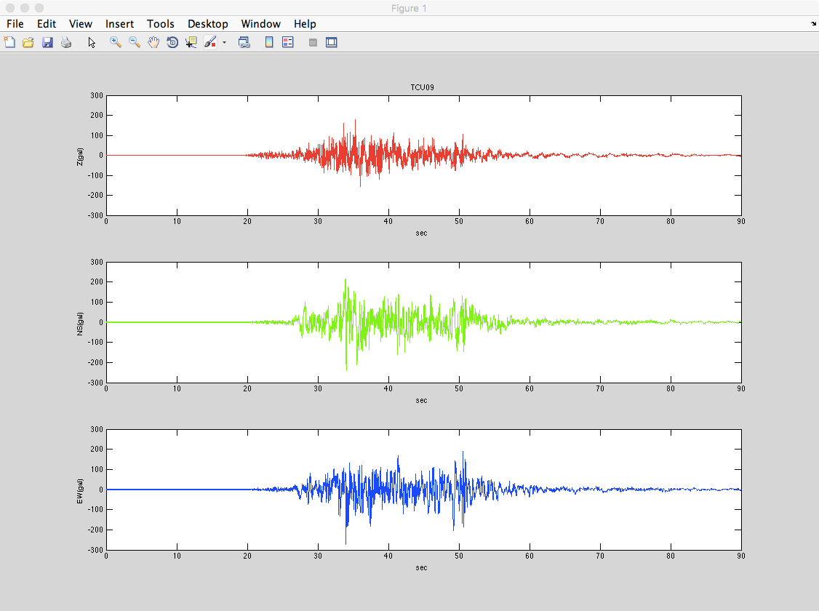

Slide 10
